Slide 1
Effect of a New Treatment (Activating Factor 42) on Gene Expression
Karl Berator

Slide 2
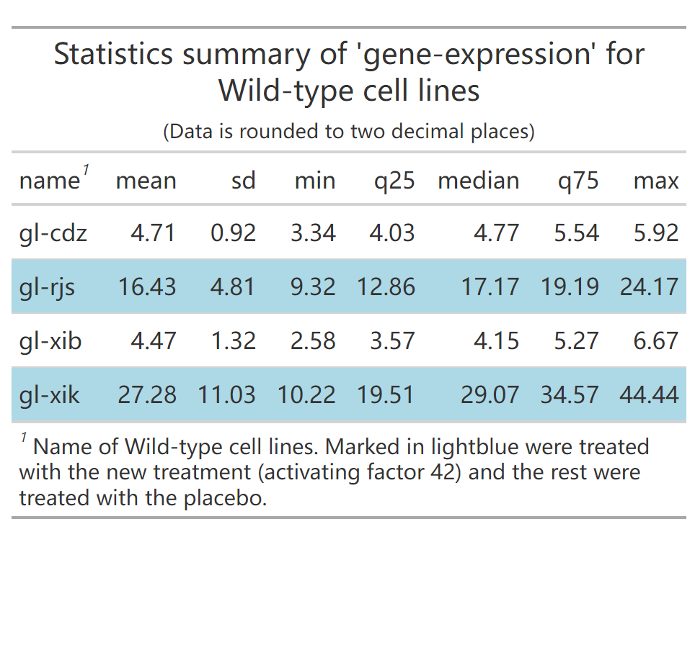
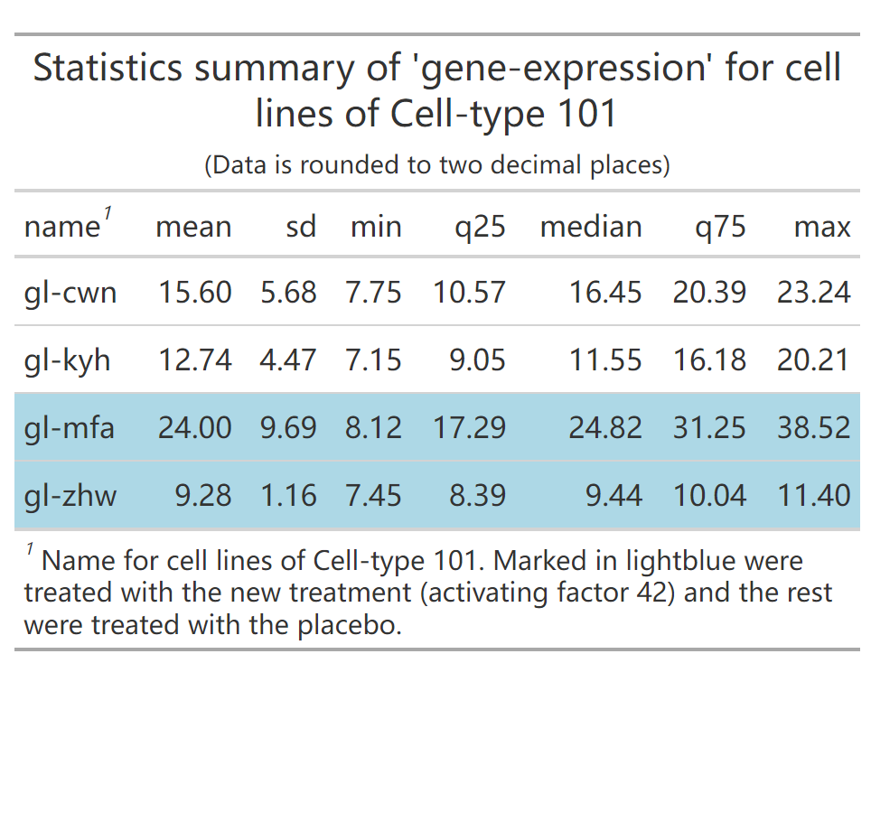
Statistics summary of “gene expression”

Slide 3
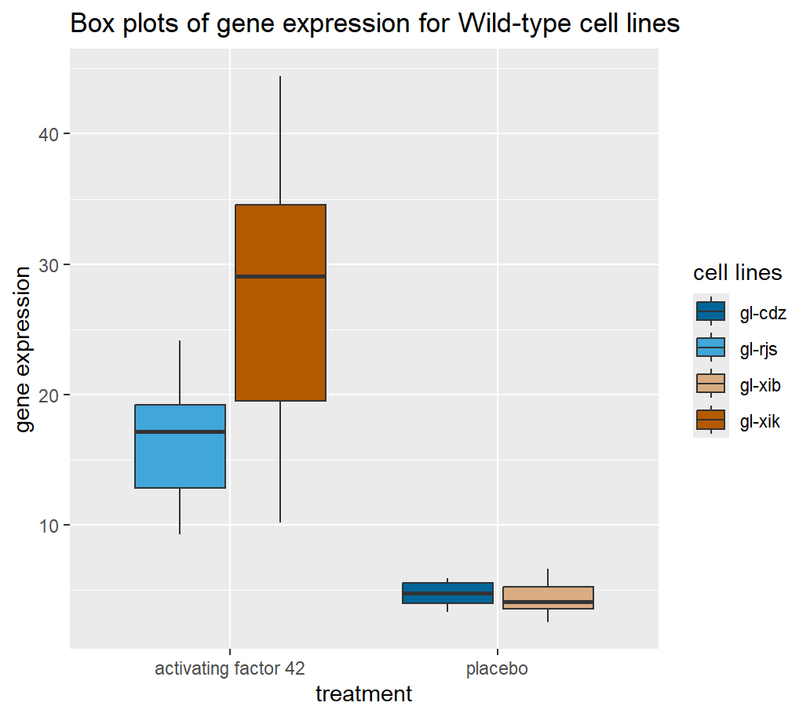
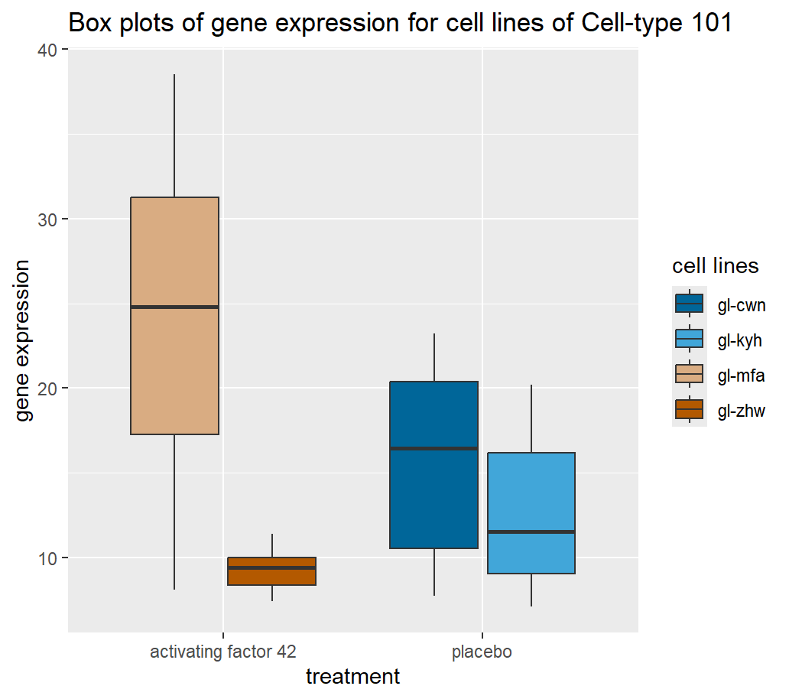

Slide 4
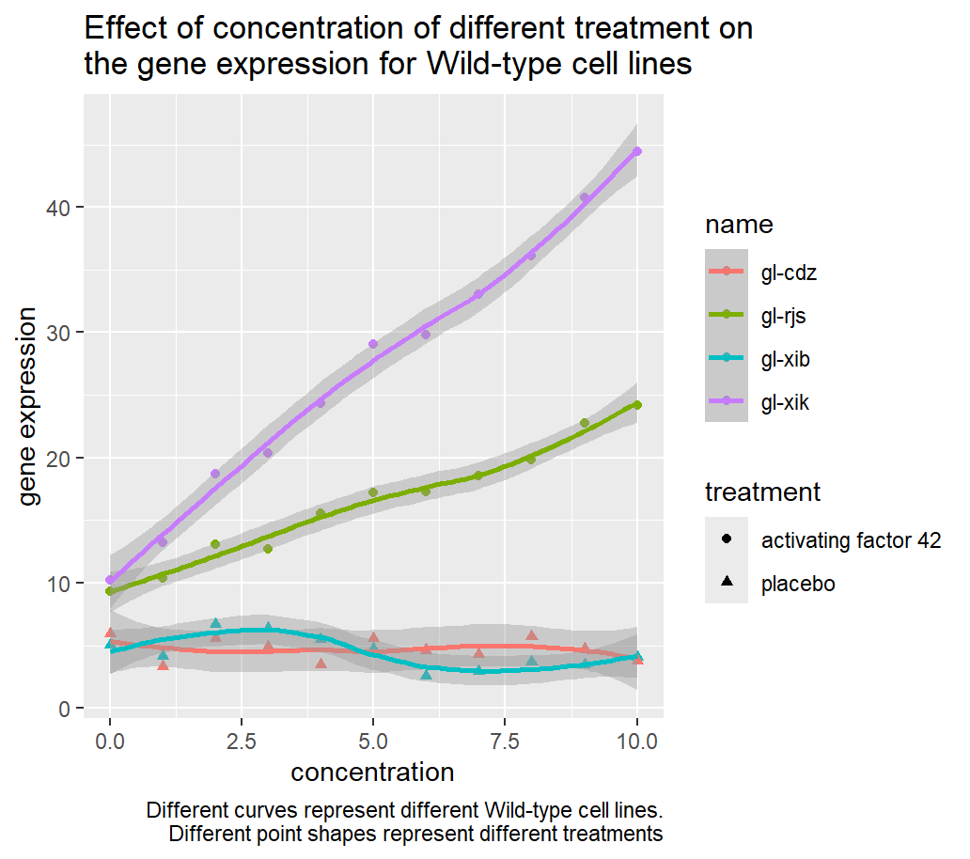
Effect of the new treatment on Gene Expression
Wild-type cell lines:
As the concentration rises, the cell lines treated with the new treatment have increasing gene expression, and this effect is particularly evident for gl-xik, while placebo had little effect on gene expression.

Slide 5
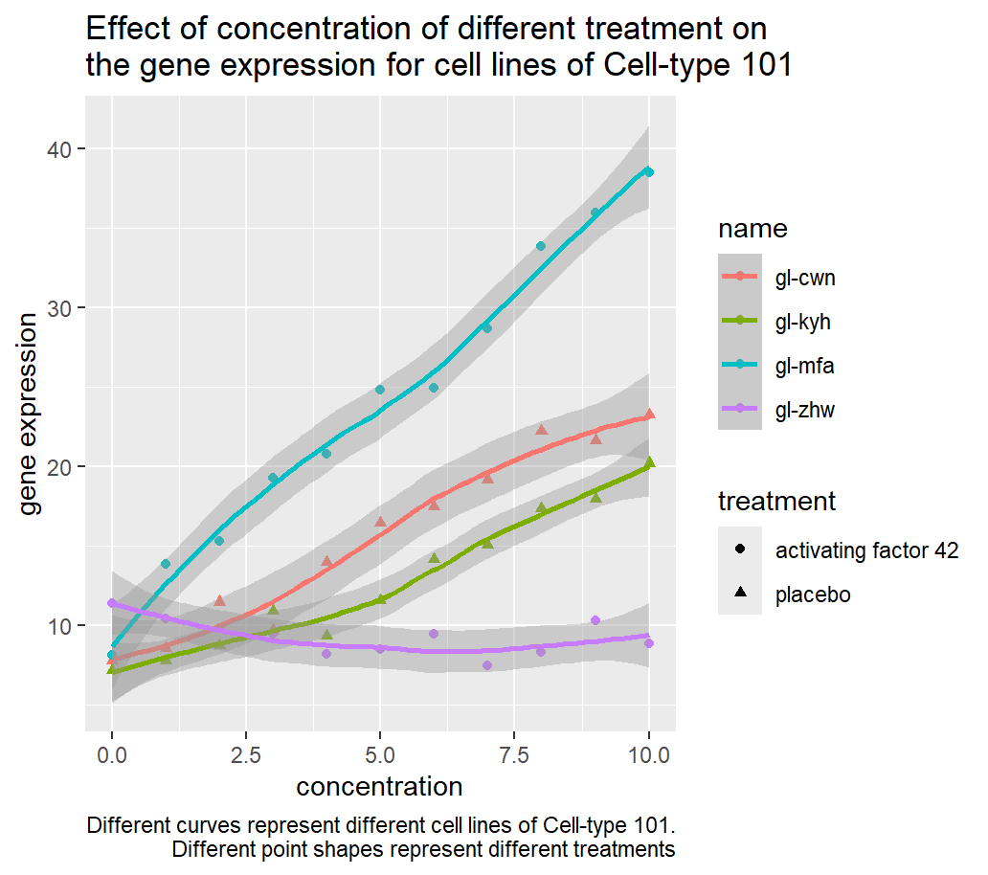
Effect of the new treatment on Gene Expression
Cell lines of Cell-type 101:
As the concentration rises, the new treatment has a more obvious promoting effect on gene expression for gl-mfa relative to the placebo.
The new treatment inhibited the gene expression of gl-zhw relative to the placebo.

